Slide 1

Yad2 updates
Project by Noam Yair

Slide 2
PROJECT OVERVIEW
My idea was to get notify by email whenever someone uploads an item to Yad2 that I'm interested in.
Since it is a secondhand platform, and most of the items that are being uploaded are singles, it will be an advantage to be updated as soon as possible.
Similar applications: for Facebook users- notifications from Facebook Marketplace
How my program works

Slide 3
GOALS
Personal goals:
improve my python programming skills.
Learn about databases – SQLite, ORM and SQLAlchemy in particular , interaction with database using python.
Technological goals: providing an external tool for websites that are updating on a daily basis

Slide 4
what I learned
How to create a database using SQLite
ORM – which allowed me to work with the database using Object Oriented code rather than writing SQL queries
Sending email with smptlib – connecting to my gmail account, attaching a file that I created and sending it as an email
Selenium – using selenium I learned how to open the page I want to explore in the browser , write in the website, click on buttons and more..

Slide 5
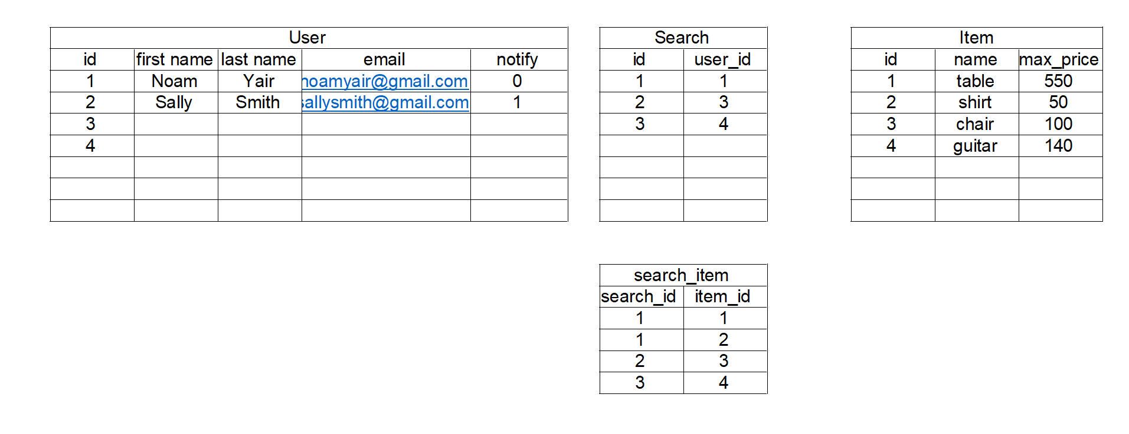
Database
I have created a database using SQLite.
Using SQLAlchemy I have created three objects: User, Search and Item.
The schema looks as follows:

Slide 6
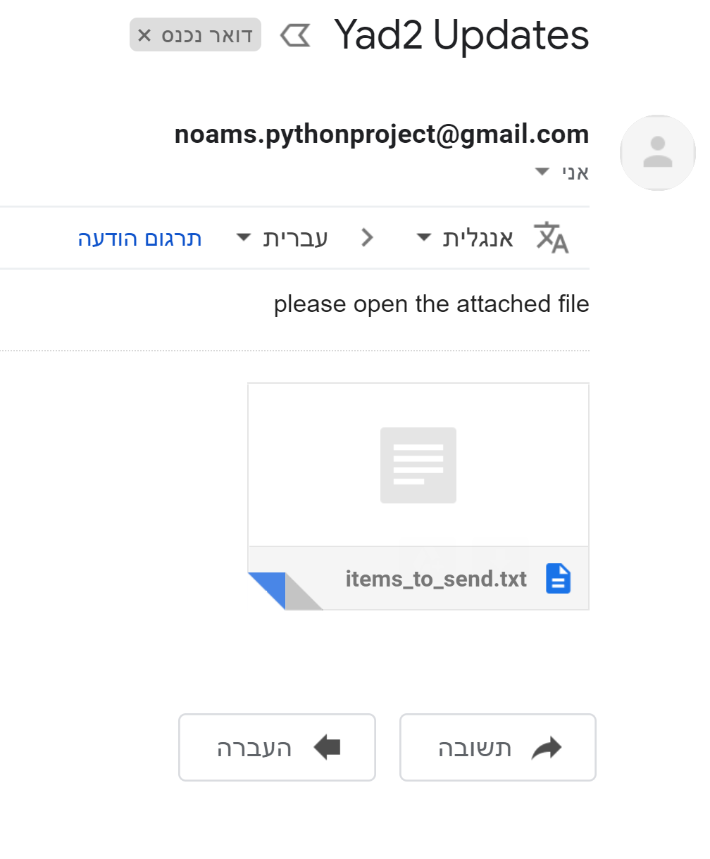
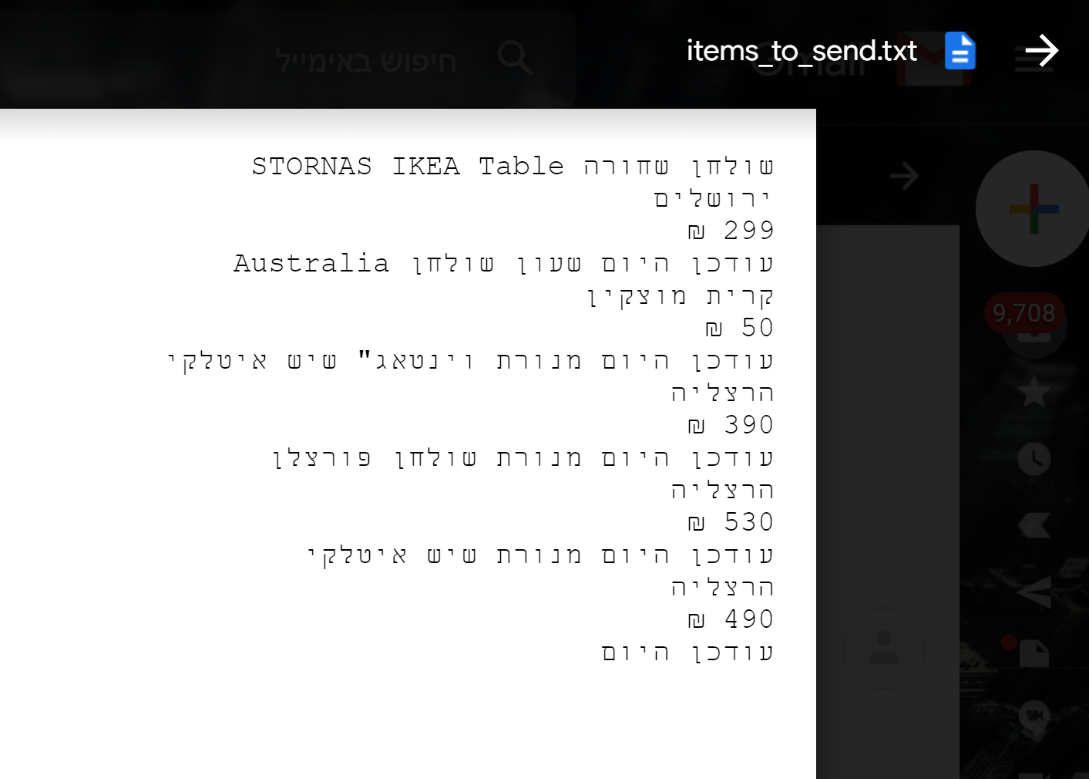
Main function
Using Selenium, I searched the items for the users.
I iterated over the users, and checked for items that were published today
Using smtplib I sent an email with a notification to update the user

Slide 7
What’s next
Make a more interactive program (more friendly to the user)
Insert timing – make the program run independently according to the user preferences
Check for extreme cases
Add more websites for the program to interact with

